Slide 1
Student-Performance-Analysis
Developed a Student Performance Analysis System using PostgreSQL (pgAdmin) and Power BI.
Designed a relational database using ERD and created tables for students, subjects, scores, attendance, and study habits.
Used SQL for data insertion, joins, aggregations, and views to analyze student performance.
Connected the database with Power BI to create interactive dashboards for performance insights.
Analyzed key metrics such as average marks, attendance, subject performance, and top-performing students.

Slide 2


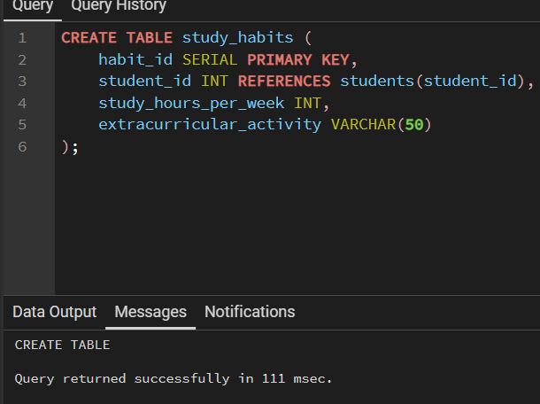
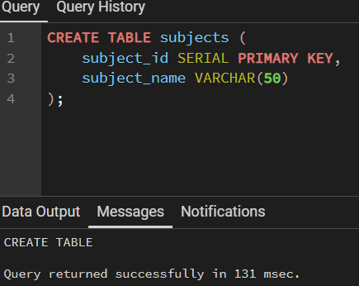

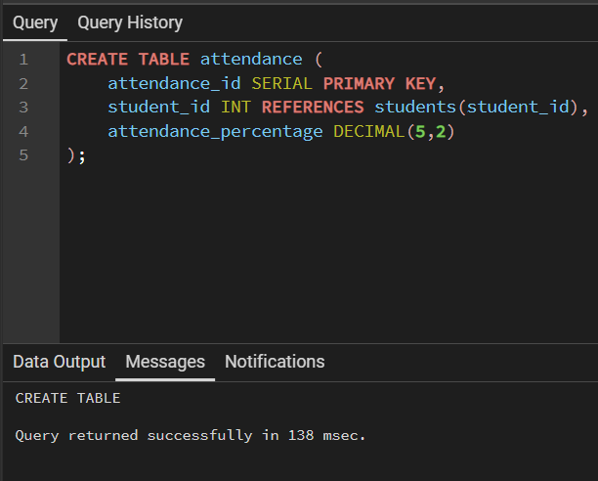
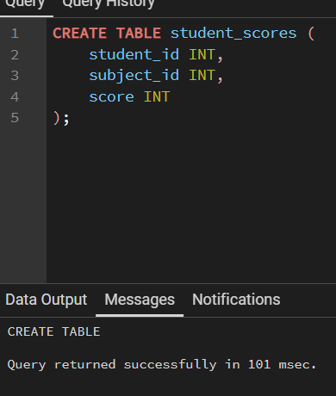
Data Definition Language
Created four Tables with subject names
student_scores,
attendance,
student_habits.

Slide 3
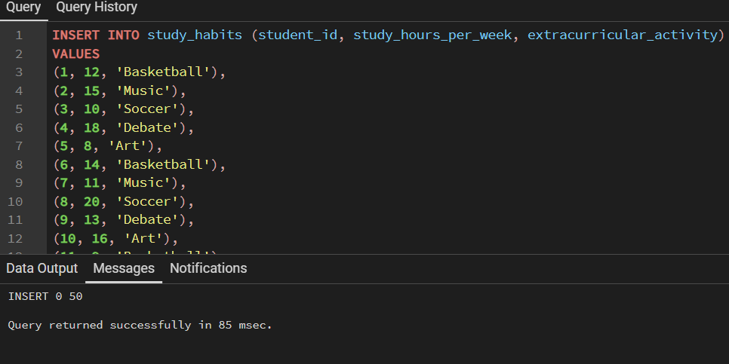
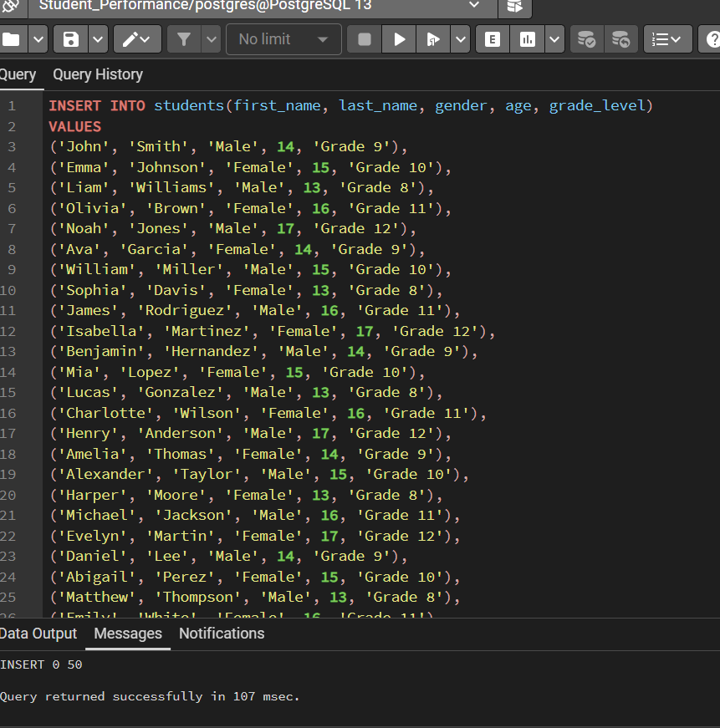
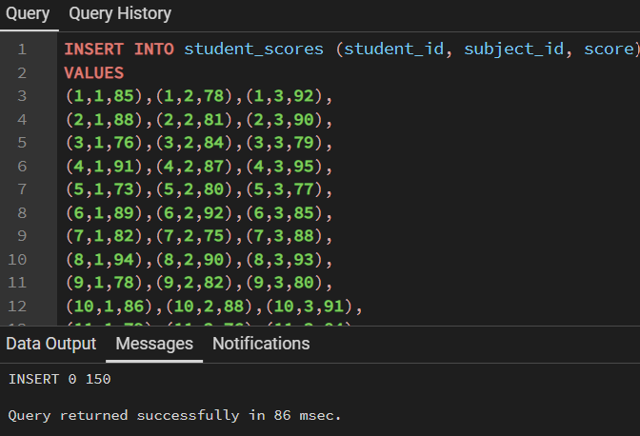
Data Manipulation Language
Inserted values into tables
Study_habits
Students
Student_scores

Slide 4
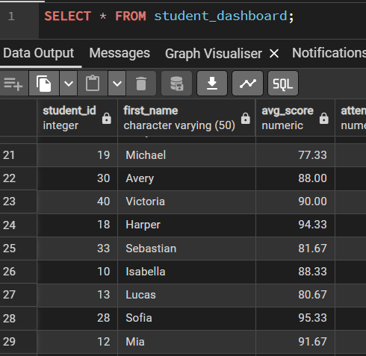
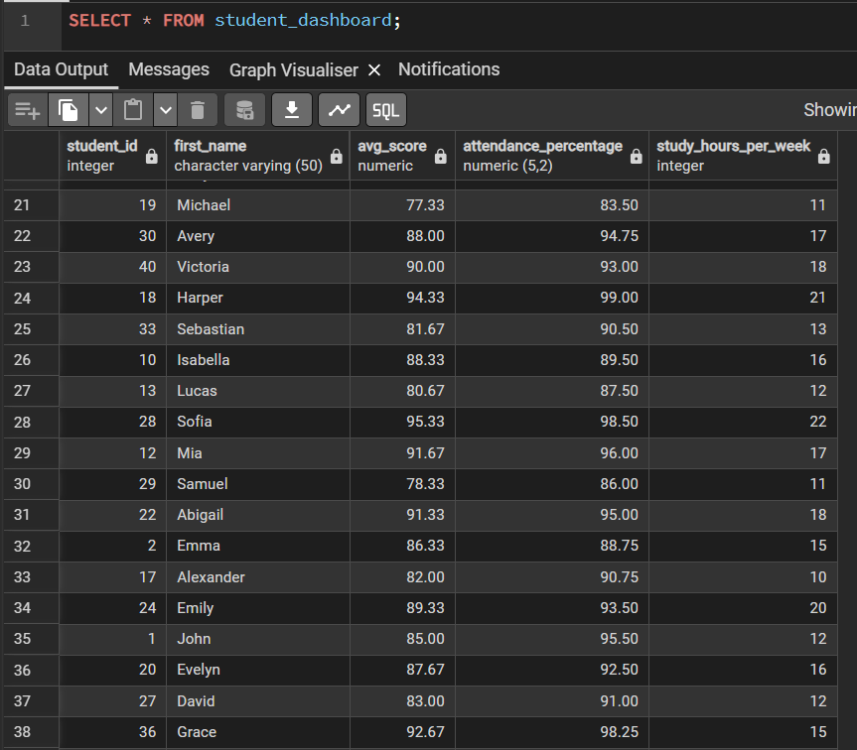
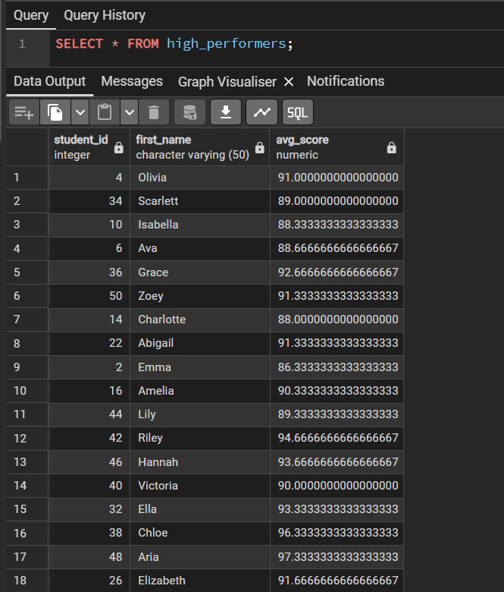
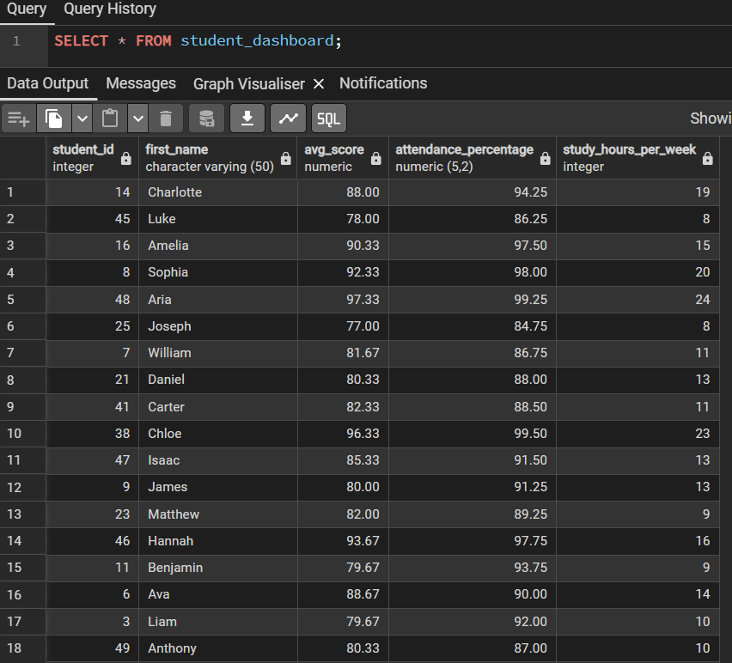
Data Query Language
Retriving tables from by using ‘select’
By using select * we can able to print all colomns and rows from tables.

Slide 5

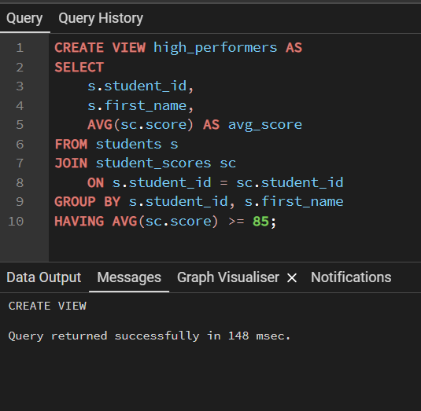
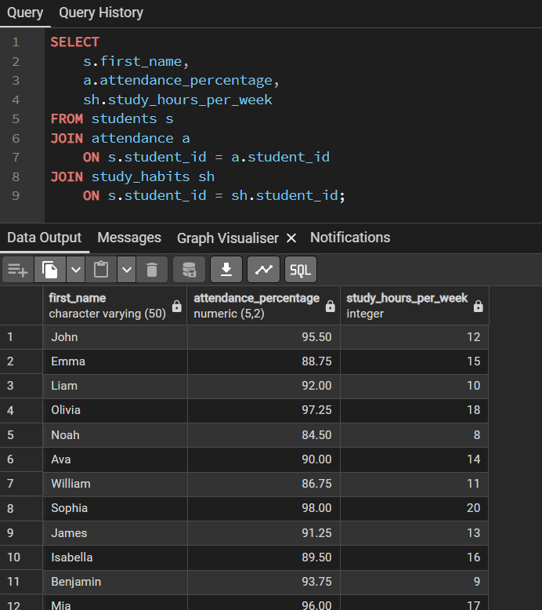

Joins

Slide 6
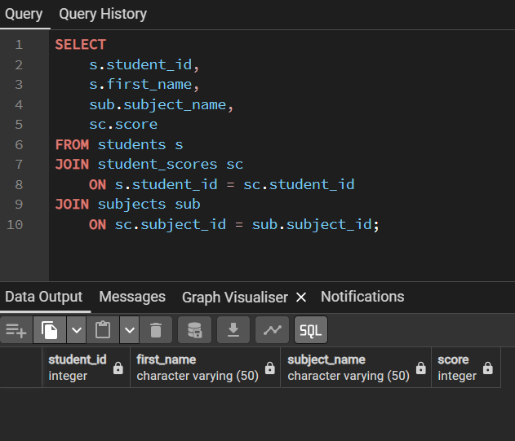
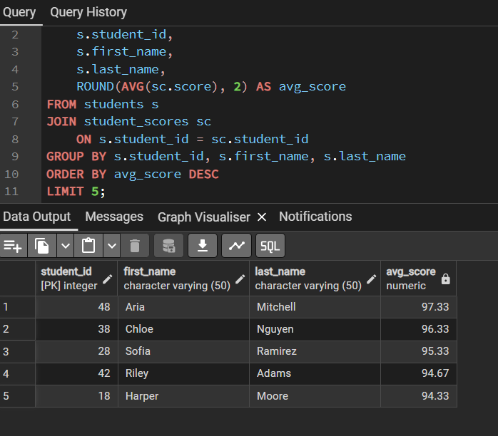
Joins

Slide 7
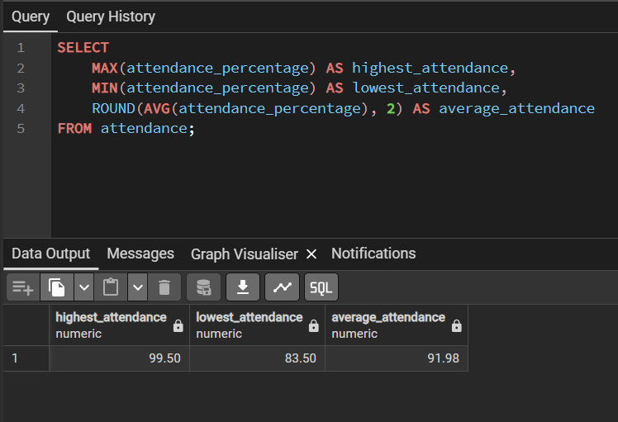
SQL Aggregation Functions
This query calculates attendance statistics from the attendance table using aggregate functions

Slide 8
Tables

